Slide 1
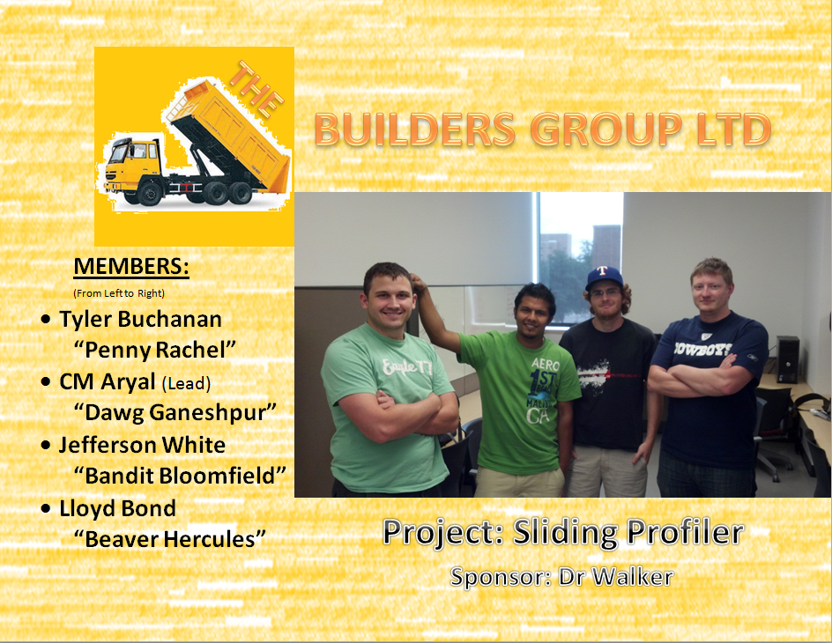

Slide 2
General Organization
Notes:
Lloyd

Slide 3
Status Monitoring
Internal
Work Breakdown Structure
Status Reports
Immediate Task Status Reporting
Scheduled Meetings
External
Team Status Reports
Team Status Update Presentations
Notes:
Lloyd

Slide 4
Roles and Responsibilities
Team Members | Responsibilities
Chudamani Aryal | Project Manager, Project planner, Integration lead, Schedule
Tyler Buchanan | Change manager, Collaborator, Document Manager
Jefferson White | Presentation, Risk Manager
Lloyd Bond | Procurement Manager, Quality Manager, Meeting scribe
Notes:
Lloyd

Slide 5
Project Constraints & Assumptions
Constraints
Time Limit
4-person team
Limited Budget
Assumptions
Weather
Maintenance
Power Availability
Notes:
Lloyd

Slide 6
Schedule & Cost Estimates
Checkpoints
Requirement Review Gate 24 July, 2012
Architectural Design Gate September, 2012
Detailed Design Gate October, 2012
Test Plan Gate November, 2012
Prototype Delivery December 2012
Cost Estimates
$ 800 Budget
Notes:
Lloyd

Slide 7
Scope Statement
Notes:
Lloyd

Slide 8
The goal of this project is to determine if early detection of inadequate ride or smoothness in Portland cement concrete (PCC) pavements can be determined and, if so, identify the appropriate correction device or procedures that can be applied before the concrete has hardened.
The upgrade will feature
PIC Microcontroller instead of an Embedded PC
GPS location tracking
More Friendly UI
Improved platform (floating capability, light weight, better mechanical design)
More tolerant components for extreme weather conditions applicable to laying concrete
Notes:
Lloyd

Slide 9
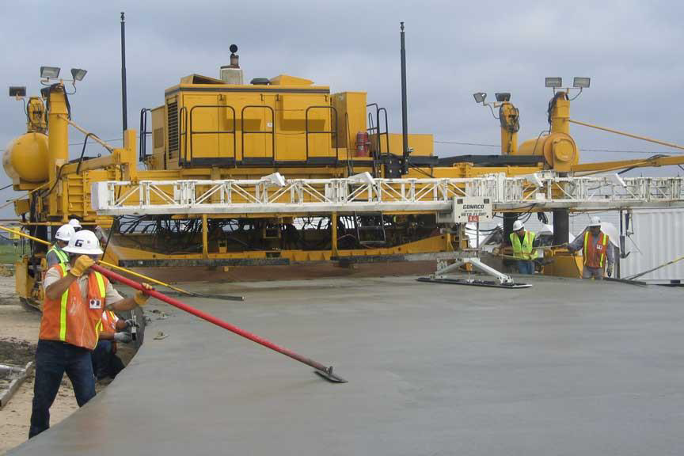
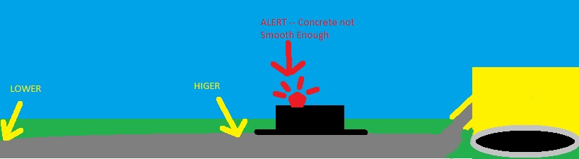
Rear view of a typical paver
Notes:
Lloyd

Slide 10
Quality Management Plan
Notes:
Lloyd

Slide 11
Overview
Component Testing
Integration Testing
Formal & Informal Test Plans
Access to Previous Test Results
Notes:
Lloyd

Slide 12
Roles and Responsibilities
Role | Responsibilities | Assigned Personnel
Quality manager | Inquire about testing progress/issues of completed components Help generate formal and informal test plans Track component testing results for future reference Report any findings and keep the group apprised of known bugs and flaws Ensure product development continues to take into account the acceptance criteria Assess priority of findings and allocate resources to address as necessary | Lloyd Bond
Notes:
Lloyd

Slide 13
Roles and Responsibilities
Role | Responsibilities | Assigned Personnel
Hardware, Software, Platform Developers | Generate informal test plans with Quality Manager’s assistance as necessary Test individual components before submission as complete Inform Quality Manager of testing generalities and any issues encountered | Team Members
Test Engineers | Follow formal test plans Perform integration testing Inform Quality Manager of results of testing and any issues encountered | Team Members
Notes:
Lloyd

Slide 14
Procurement Management Plan
Notes:
Lloyd

Slide 15
Roles and Responsibilities
Role | Responsibilities | Assigned Personnel
Project Sponsor | Make purchasing approvals | Roger Walker
Team Supervisor | Make purchasing approvals | Michael O’Dell
Procurement Manager | Work with Lead Architect to identify project procurement needs Perform procurement cost analysis Obtain procurement approval Track purchase orders Report completed purchases | Lloyd Bond
Notes:
Lloyd

Slide 16
Roles and Responsibilities
Role | Responsibilities | Assigned Personnel
Integration Lead | Work with Procurement Manager, Hardware Architect, Software Architect, Platform Architect to identify purchasing needs | Chudamani Aryal
Team Members | Perform procurement identification as necessary according to role | Chudamani Aryal, Tyler Buchanan, Jefferson White, Lloyd Bond
Notes:
Lloyd

Slide 17
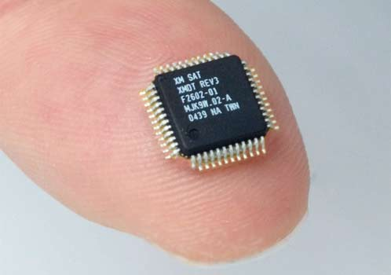
Cost Management Plan
Notes:
CM

Slide 18
Labor Management
Breakdown of Schedule
Work Allocation
Team Meetings
Internal Deadlines
Material Management
Approval of Purchase Order
Response to Cost Variances
Use of Re-Useable Materials
Notes:
CM

Slide 19
Work Breakdown Structure
Notes:
CM

Slide 20
Phase 1
SRS
Project Charter
Team Meetings
Sponsor Meetings
R&D
Notes:
CM

Slide 21
Phase 2
ADS
DDS
Test Plan
Implementation
Team Meetings
Sponsor Meetings
Notes:
CM

Slide 22
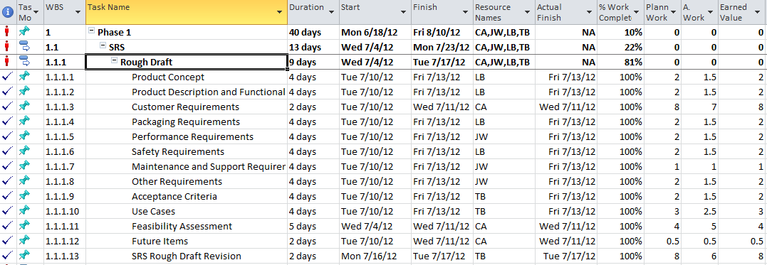
MS Project Sample
Notes:
CM

Slide 23
Earned Value Management
Notes:
Jeff

Slide 24
Measurement
Budgeted Cost of Work Scheduled (BCWS)
Actual Cost of Work Performed (ACWP)
Budgeted Cost of Work Performed (BCWP)
Notes:
Jeff

Slide 25
Reporting
Cost Performance Index
CPI = BCWP/ACWP
Schedule Performance Index
SPI = BCWP/BCWS
Analysis
CPI > 1.0 = exceptional performance
CPI < 1.0 = poor performance
Similar for SPI
Notes:
Jeff

Slide 26
Change Management Plan
Notes:
Jeff

Slide 27
Roles and Responsibilities
Project Sponsor
Project Manager
Change Manager
Project Team
Notes:
Jeff

Slide 28
Review & Approval Process
Analysis of Impact
Discussion
Approval
Plan of Action
Notes:
Jeff

Slide 29
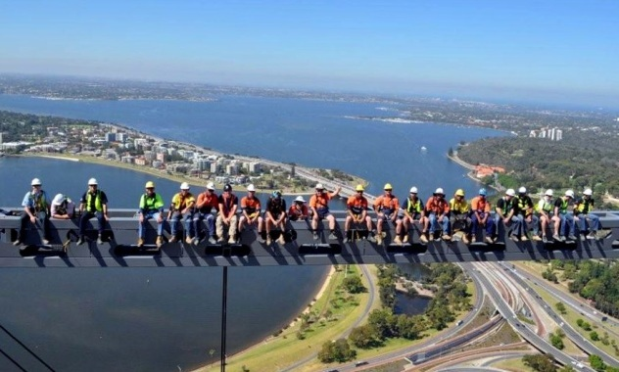
Risk Management Plan
Notes:
Jeff

Slide 30
Roles and Responsibilities
Project Sponsor
Project Manager
Risk Manager
Project Team
Notes:
Jeff

Slide 31
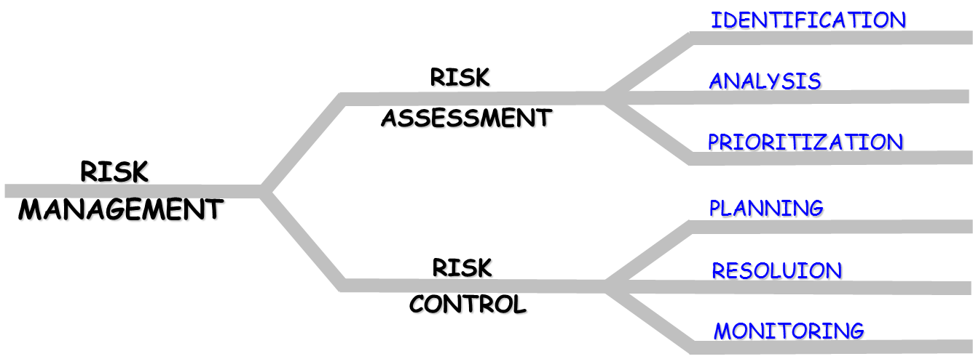
Risk Management Steps
Source: Mr. Mike O’Dell
Notes:
Jeff

Slide 32
Risk Analysis Sample
Name | Priority(1-5) | Likelihood(%) | Size of loss (weeks) | Severity (likelihood x size of loss)
Burnout | 1-2 | 95 | 2 | 1.9
Personnel Availability | 4 | 80 | 2 | 1.6
Doesn't float | 1 | 40 | 3 | 1.2
Extreme Temp Failure | 1 | 40 | 3 | 1.2
Project Failure | 1 | 30 | 4 | 1.2
Sponsor Availability | 5 | 50 | 2 | 1
Frame Resilience | 4 | 30 | 2 | 0.6
Lack of Buy-in | 5 | 20 | 3 | 0.6
Notes:
Jeff

Slide 33
Scope Management Plan
The scope of this project will be defined by the baseline requirement specification
Any possible changes to the scope will be discussed with the team and project sponsor
Notes:
Tyler

Slide 34
Communications Plan
Notes:
Tyler

Slide 35
Internal Communications
Meetings
Phone
Emails
GitHub
Notes:
Tyler

Slide 36
External Communications
Includes Sponsor and Team Supervisor
Emails
Personal Meetings
Notes:
Tyler

Slide 37
Project Closeout Report
Notes:
Tyler

Slide 38
Administrative Closure
Objectives Met
Archiving Project Artifacts
Lessons Learned Sessions
Post Review
Final Customer Acceptance
Final Project Performance Report
Notes:
Tyler

